Slide 1

Forecasting Energy Demand In New South Wales:
Analysis of Temperature, Price, Holidays, and Population Trends
Group K Presentation

Slide 2




Abdelrhman Dameen (z5427841)
Md Nezam Uddin (z5339862)
Introduce Group K
Pam Moodley (z5366156)
Van Hai Ho (z3071030)

Slide 3
Agenda (AD)
Introduction (Abdo)
Literature Review (Abdo)
Project’s Flow (Pam)
Data Analysis and Results (Van & Nezam)
Conclusion (Abdo)
References & Acknowledgements

Slide 4
Literature Review (AD)

Slide 5
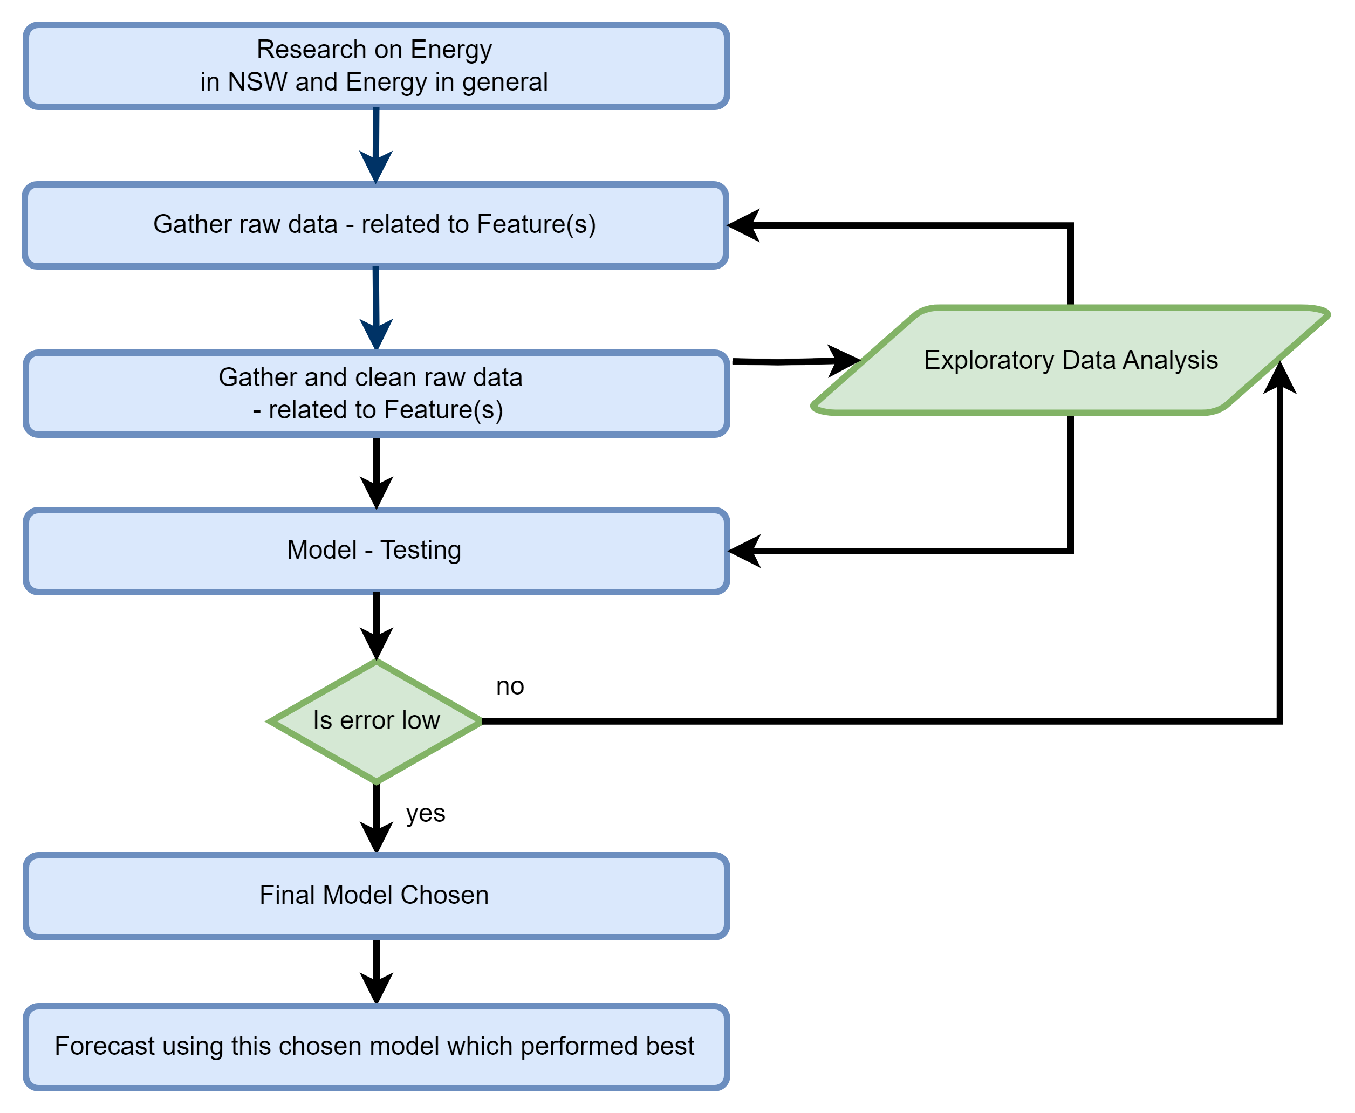
Project's Flow (PM)

Slide 6
Importance of the Study (PM)
Volatile Energy Market
Many factors influencing the demand for energy

Slide 7
Methodology (PM)
Learning algorithms were employed
Linear Regression
Multi-Layer Perceptron
Random Forest
Facebook Prophet
XGBoost
Assessed using
MAPE
MAE
RMSE

Slide 8
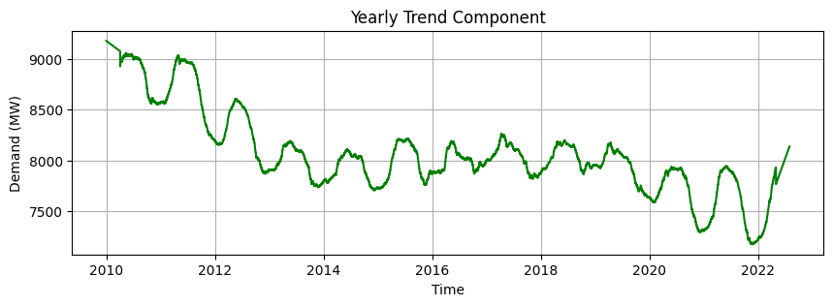
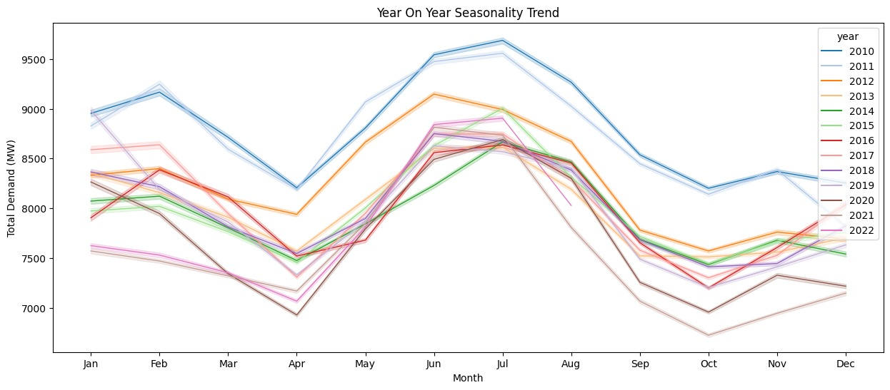
Yearly Total Demand Trend (PM)
Explain this

Slide 9
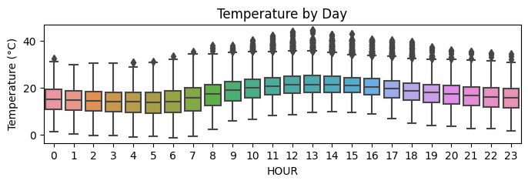
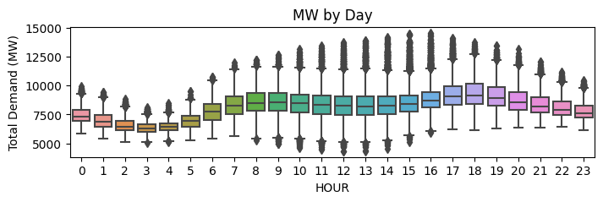
Total Energy Demand by Hour (VH)
Energy demand increases through the day as air temperature increases.
Demand peaks around 6pm.
Demand drops as air temperature decreases.
Demand is low between 2am and 3am in the morning.

Slide 10
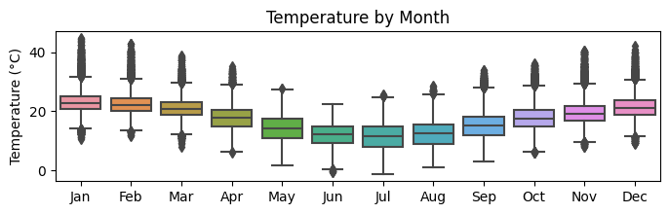
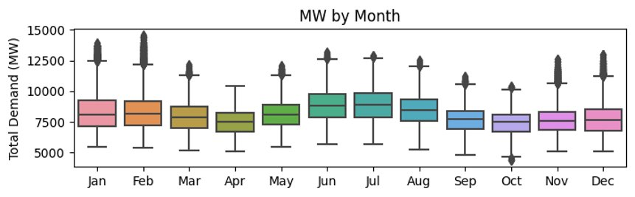
Total Energy Demand by Month (VH)

Slide 11
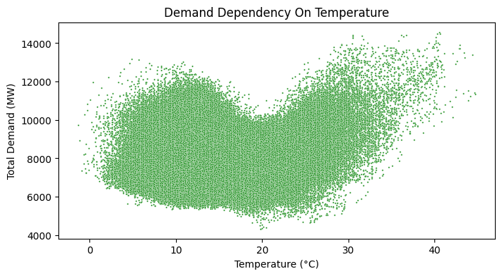
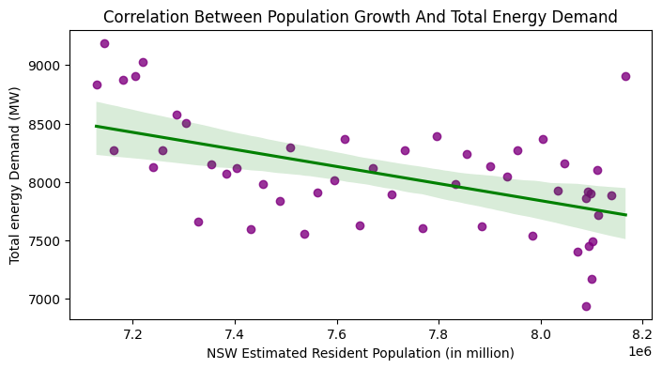
Total Demand vs Temperature and Population Growth (VH)
Non-Linear relationship
Inverse relationship: Total Energy Demand decreases despite the population growth.

Slide 12
Interpretation (Not sure)
Important Graphs but not sure where to add these

Slide 13
Analysis and Results (NU)
Benchmark Evaluation Matrices
Method | MAPE | MAE | RMSE
 | 2.47% | 204.03 | 280.45

Slide 14
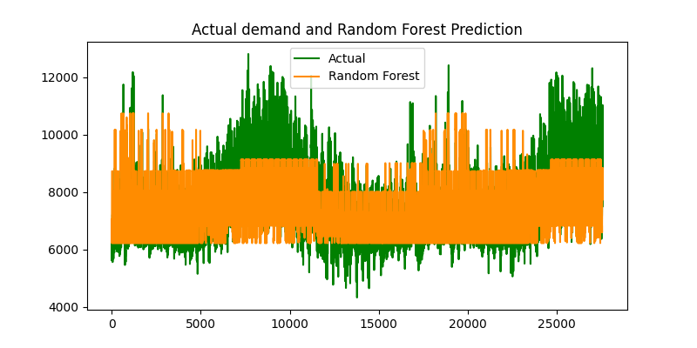
Analysis and Results (NU)
Initial Models
How well Random Forest fits the actual demand
Evaluation Matrices - with Temperature and Time Series as Inputs
Model | Data | MAPE | MAE | RMSE
Linear Regression | train | 10.61% | 855.53 | 1080.71
 | test | 11.42% | 883.42 | 1146.06
MLP | train | 10.9% | 887.54 | 1117.27
 | test | 13.72% | 1007.23 | 1222.41
Random Forest | train | 6.99% | 573.81 | 763.94
 | test | 11.32% | 833.06 | 1083.93
Random Forest model outperforms both Linear Regression and MLP with an MAPE and RMSE score of 11.32% and 1083.93
Performances of Random Forest is average
It mostly fails to predict when energy demand is high or low

Slide 15
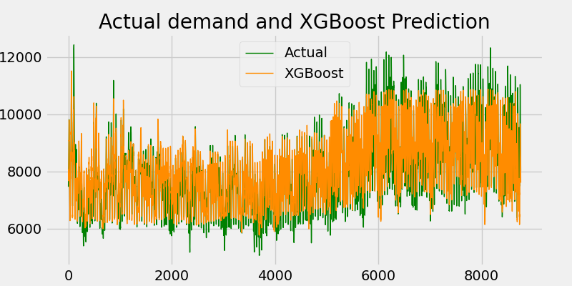
Analysis and Results (NU)
Main Model
Evaluation matrices- temperature, price, holiday, and time-series features are factors.
Model | Data | MAPE | MAE | RMSE
XGBoost | train | 5.87% | 482.47 | 646.42
 | test | 7.03% | 542.75 | 714.74
How well XGBoost predict the actual demand
In addition to the time series features three more factors are added
XGBoost MAPE value of 7% outperformed Random Forest MAPE value of 11.32
XGBoost overcame the overfitting issue

Slide 16
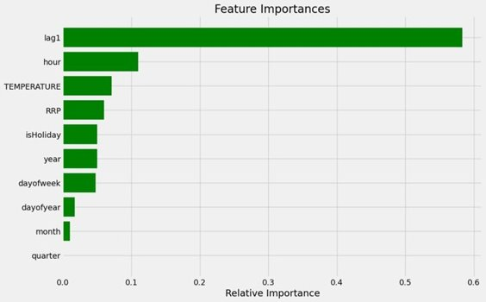
Implications (NU)

Slide 17
Conclusion (AD / VH)

Slide 18
References and Acknowledgments
IEA (2016) ‘World energy outlook 2016’. Available at: link . Majid Emami Javanmard, S.F. Ghaderi (2023) ‘Energy demand forecasting in seven sectors by an optimization model based on machine learning algorithms’. Available at: 🔗 link.

Slide 22
References

Slide 23


Slide 24


Slide 25
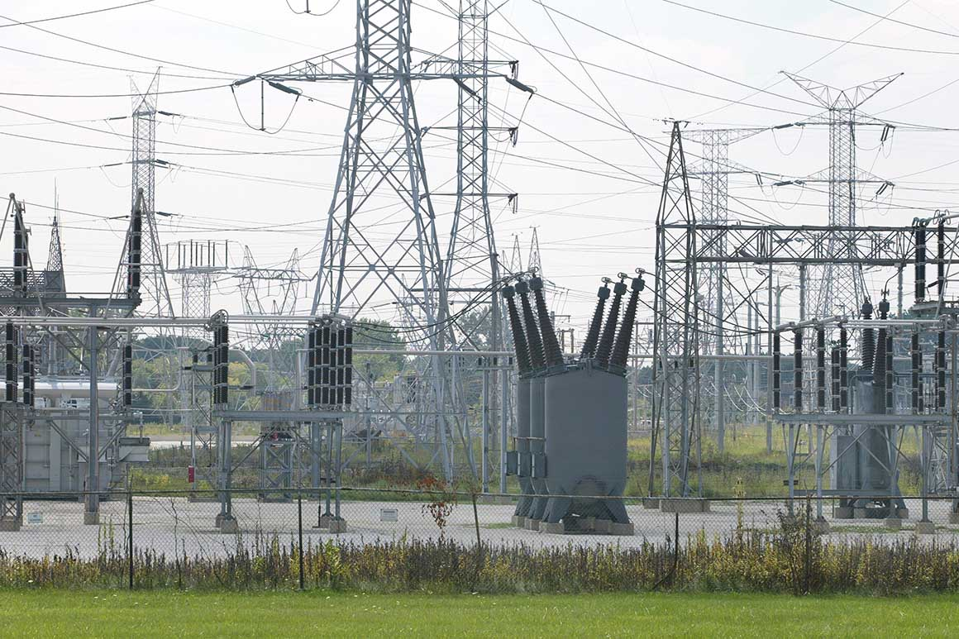

Slide 26


Slide 27
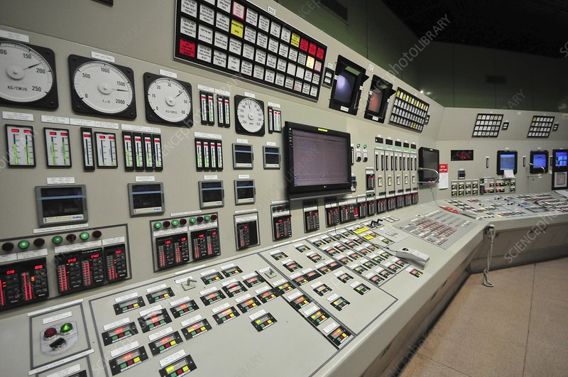

Slide 28


Slide 29


Slide 30
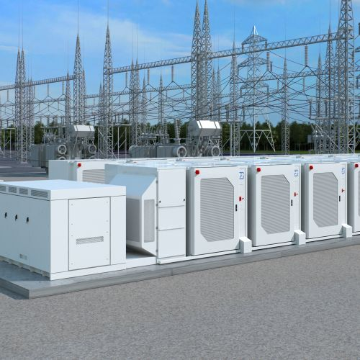

Slide 31


Slide 32


Slide 35


Slide 36


Slide 37
